Slide 1
Chapter 18: Concurrency Control
Notes:
并发控制保证多个事务并发执行如同串行调度一样获得正确的运行结果。讲解基于锁的并发控制协议的主要思想、两阶段封锁协议（2PL）、死锁及解决办法、多粒度锁, 以及数据删除和插入情况下的并发控制。

Slide 2
Lock-Based Protocols
A lock is a mechanism to control concurrent access to a data item
Data items can be locked in two modes :
1. exclusive (X) mode. Data item can be both read as well as
written. X-lock is requested using lock-X instruction.
2. shared (S) mode. Data item can only be read. S-lock is
requested using lock-S instruction.
Lock requests are made to concurrency-control manager. Transaction can proceed only after request is granted.

Slide 3

Lock-Based Protocols (Cont.)
Lock-compatibility matrix
A transaction may be granted a lock on an item if the requested lock is compatible with locks already held on the item by other transactions
Any number of transactions can hold shared locks on an item,
  but if any transaction holds an exclusive on the item no other transaction may hold any lock on the item.
If a lock cannot be granted, the requesting transaction is made to wait till all incompatible locks held by other transactions have been released. The lock is then granted.

Slide 4
The Two-Phase Locking Protocol
This is a protocol which ensures conflict-serializable schedules.
Phase 1: Growing Phase
  transaction may obtain locks
  transaction may not release locks
Phase 2: Shrinking Phase
  transaction may release locks
  transaction may not obtain locks
lock-S(A);
read (A);
lock-S(B); ← lock point
read (B);
unlock(A);
unlock(B);
display(A+B)
Growing Phase
lock point
Shrinking Phase
Locks
Time

Slide 5
The Two-Phase Locking Protocol
Two-Phase Locking Protocol assures serializability.
It can be proved that the transactions can be serialized in the order of their lock points (i.e. the point where a transaction acquired its final lock).

Slide 6
2PL - Proof by Contradiction 反证法
In the precedence graph corresponding to a schedule of a set of transactions T₁, T2, ..., T_{n}, if there is an arc from T_{i} to T_{j} , then LP(T_{i})< LP(T_{j})
(LP : Lock Point) 按照两阶段， lock point的时间单调，因此不能有环
LP(T_{i}) < LP(T_{j})
T_{i}
T_{j}
(2) unlock(D)
(3) lock(D)
(1) lock(D)
(4) unlock(D)
D
time

Slide 7
2PL - Proof by Induction
Let T_{i} is the transaction with minimum lock point（LP）.
If there is an operation OP_{j} of another transaction T_{j} that blocks an operation OP_{i} of T_{i} …
OP_{j}
OP_{i}
(2)unlock(D)
(3) lock(D)
(1) lock(D)
(4) unlock(D)
D
time
LP(T_{j}) < LP(T_{i})

Slide 8
The Two-Phase Locking Protocol (Cont.)
Extensions to basic two-phase locking（基本两阶段封锁） needed to ensure recoverability of freedom from cascading roll-back
  Strict two-phase locking（严格两阶段封锁）: a transaction must hold all its exclusive locks till it commits/aborts.
    Ensures recoverability and avoids cascading roll-backs
  Rigorous two-phase locking（强两阶段封锁）: a transaction must hold all locks till commit/abort.
    Transactions can be serialized in the order in which they commit.
Most databases implement rigorous two-phase locking, but refer to it as simply two-phase locking

Slide 9
The Two-Phase Locking Protocol (Cont.)
Two-phase locking is not a necessary condition for serializability.
There can be conflict serializable schedules that cannot be obtained if two-phase locking is used.
However, in the absence of extra information (e.g., ordering of access to data), two-phase locking is needed for conflict serializability .

Slide 10
Exercise
The following is a schedule of the transactions T1,T2,T3:
  Draw the precedence graph of the schedule
  Is the schedule conflict serializable? 可以
  Can the schedule be generated by the 2PL protocol?
T1 | T2 | T3
lock-X(C)
write C
unlock(C)
 | lock-X(C)
 | write C
 | unlock(C)
 |  | lock-X(A)
 |  | write A
 |  | unlock(A)
lock-X(A)
write A
unlock(A)
T1 | T2 | T3
write C
 | write C
 |  | write A
write A
T1
T2
T3

Slide 11
Lock Conversions
Two-phase locking with lock conversions:
– First Phase:
  can acquire a lock-S or lock-X on a data item
  can convert a lock-S to a lock-X
  (lock-upgrade)
– Second Phase:
  can release a lock-S or lock-X
  can convert a lock-X to a lock-S
  (lock-downgrade)
This protocol assures serializability.
(Please prove it !)
LP(T_{i}) < LP(T_{j})
T_{i}
T_{j}
(3) lock(D)
lock-upgrade(D)
(2) unlock(D)
lock-downgrade(D
lock(D)
lock-upgrade(D)
(4) unlock(D)
lock-downgrade(D)
D
time

Slide 12
Automatic Acquisition of Locks
A transaction T_{i} issues the standard read/write instruction, without explicit locking calls.
The operation read(D) is processed as:
if T_{i} has a lock on D
then
read(D)
else begin
if necessary wait until no other
transaction has a lock-X on D
grant T_{i} a lock-S on D;
read(D)
end

Slide 13
Automatic Acquisition of Locks (Cont.)
write(D) is processed as:
if T_{i} has a lock-X on D
then
write(D)
else begin
if necessary wait until no other trans. has any lock on D,
if T_{i} has a lock-S on D
then
upgrade lock on D to lock-X
else
grant T_{i} a lock-X on D
write(D)
end;
All locks are released after commit or abort

Slide 14
Implementation of Locking
A lock manager can be implemented as a separate process to which transactions send lock and unlock requests
The lock manager replies to a lock request by sending a lock grant messages (or a message asking the transaction to roll back, in case of a deadlock)
The requesting transaction waits until its request is answered
The lock manager maintains a data-structure called a lock table to record granted locks and pending requests
The lock table is usually implemented as an in-memory hash table indexed on the name of the data item being locked

Slide 15
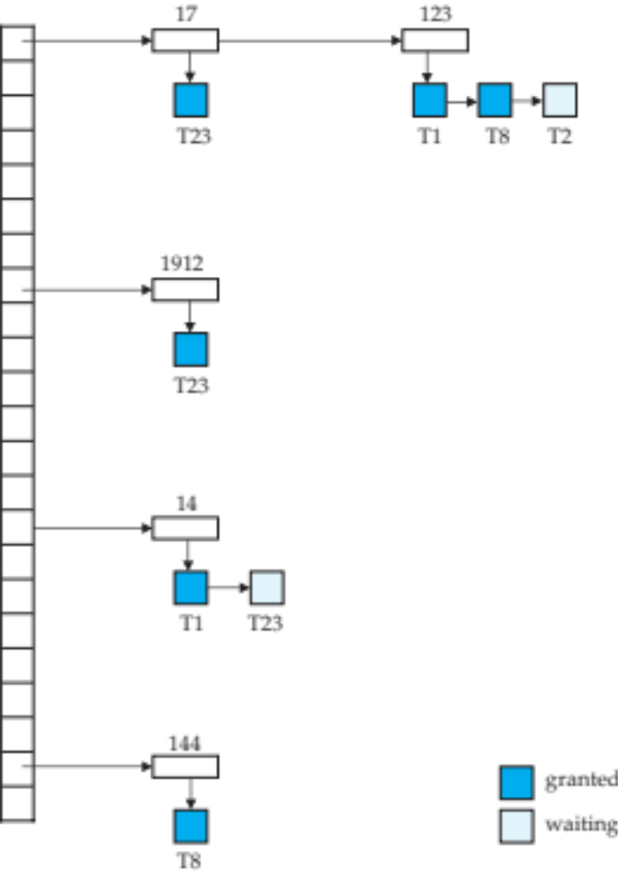
Lock Table
Lock table records granted locks and waiting requests
Lock table also records the type of lock granted or requested
New request is added to the end of the queue of requests for the data item, and granted if it is compatible with all earlier locks
Unlock requests result in the request being deleted, and later requests are checked to see if they can now be granted
If transaction aborts, all waiting or granted requests of the transaction are deleted
  lock manager may keep a list of locks held by each transaction, to implement this efficiently

Slide 16

Deadlock Handling
System is deadlocked if there is a set of transactions such that every transaction in the set is waiting for another transaction in the set.
Two-phase locking does not ensure freedom from deadlocks
Consider the following two transactions:
T₁: write (X) T₂: write(Y)
write(Y) write(X)
Schedule with deadlock

Slide 17
Deadlock Handling
Deadlock prevention protocols ensure that the system will never enter into a deadlock state. Some prevention strategies :
  Require that each transaction locks all its data items before it begins execution (predeclaration).
  Impose partial ordering of all data items and require that a transaction can lock data items only in the order specified by the partial order (graph-based protocol).
Timeout-Based Schemes:
  a transaction waits for a lock only for a specified amount of time. After that, the wait times out and the transaction is rolled back.
  thus deadlocks are not possible
  simple to implement; but starvation is possible. Also difficult to determine good value of the timeout interval.

Slide 18


Deadlock Detection
Deadlocks can be described as a wait-for graph, which consists of a pair G = (V,E),
  V is a set of vertices (all the transactions in the system)
  E is a set of edges; each element is an ordered pair T_{i} →T_{j}.
If T_{i} → T_{j} is in E, then there is a directed edge from T_{i} to T_{j}, implying that T_{i} is waiting for T_{j} to release a data item.
When T_{i} requests a data item currently being held by T_{j}, then the edge T_{i} T_{j} is inserted in the wait-for graph. This edge is removed only when T_{j} is no longer holding a data item needed by T_{i}.
The system is in a deadlock state if and only if the wait-for graph has a cycle. Must invoke a deadlock-detection algorithm periodically to look for cycles.

Slide 19
Deadlock Recovery
When deadlock is detected :
  Some transaction will have to rolled back (made a victim) to break deadlock. Select that transaction as victim that will incur minimum cost.
  Rollback -- determine how far to roll back transaction
    Total rollback: Abort the transaction and then restart it.
    More effective to roll back transaction only as far as necessary to break deadlock.
  Starvation happens if same transaction is always chosen as victim. Include the number of rollbacks in the cost factor to avoid starvation

Slide 20
Exercise
Following figure shows an example of a lock table. There are 6 transactions(T1-T6) and 6 data items(I1, I11, I5, I15, I9, I19, I29). Granted locks are filled (black) rectangles, while waiting requests are empty rectangles.
Which transaction are involved in deadlock?
To break the deadlock, which transaction should be rolled back?
What kind data structure can be helpful for a transaction to efficiently release all locks its holds when it commits?
I1
I11
T2
T1
T1
T6
I5
I15
T3
T5
T6
T2
T5
I9
I19
I29
T2
T3
T3
T4
T2

Slide 21

Graph-Based Protocols
Graph-based protocols are an alternative to two-phase locking
Impose a partial ordering → on the set D = {d₁, d₂ ,..., d_{h}} of all data items.
  If d_{i} → d_{j} then any transaction accessing both d_{i} and d_{j} must access d_{i} before accessing d_{j}.
  Implies that the set D may now be viewed as a directed acyclic graph, called a database graph.

Slide 22
Tree Protocol
The tree-protocol is a simple kind of graph protocol.
Only exclusive locks are allowed.
The first lock by T_{i} may be on any data item. Subsequently, a data Q can be locked by T_{i} only if the parent of Q is currently locked by T_{i}.
Data items may be unlocked at any time.
A data item that has been locked and unlocked by T_{i} cannot subsequently be relocked by T_{i}
X
X
X
X

Slide 23
Graph-Based Protocols (Cont.)
The tree protocol ensures conflict serializability as well as freedom from deadlock.
Advantages
  Unlocking may occur earlier in the tree-locking protocol than in the two-phase locking protocol.
    shorter waiting times, and increase in concurrency
  protocol is deadlock-free
    no rollbacks are required
Disadvantages
  Protocol does not guarantee recoverability or cascade freedom
    Need to introduce commit dependencies to ensure recoverability
  Transactions may have to lock more data items than needed.
    increased locking overhead, and additional waiting time
    potential decrease in concurrency
Schedules not possible under two-phase locking are possible under tree protocol, and vice versa.

Slide 24
Multiple Granularity(多粒度)
Allow data items to be of various sizes and define a hierarchy of data granularities, where the small granularities are nested within larger ones
Can be represented graphically as a tree (but don't confuse with tree-locking protocol)
When a transaction locks a node in the tree explicitly, it implicitly locks all the node's descendents in the same mode.
Granularity of locking (level in tree where locking is done):
  fine granularity（细粒度） (lower in tree): high concurrency, high locking overhead
  coarse granularity（粗粒度） (higher in tree): low locking overhead, low concurrency

Slide 25

Example of Granularity Hierarchy
The levels, starting from the coarsest (top) level are
  database
  area
  File（table)
  record
S ，X
，IS，IX，SIX
S ，X
，IS，IX，SIX
S，X

Slide 26
Intention Lock Modes
In addition to S and X lock modes, there are three additional lock modes with multiple granularity:
  intention-shared (IS): indicates explicit locking at a lower level of the tree but only with shared locks.
  intention-exclusive (IX): indicates explicit locking at a lower level with exclusive or shared locks
  shared and intention-exclusive (SIX): the subtree rooted by that node is locked explicitly in shared mode and explicit locking is being done at a lower level with exclusive-mode locks.
intention locks allow a higher level node to be locked in S or X mode without having to check all descendent nodes.

Slide 27

Compatibility Matrix with Intention Lock Modes
The compatibility matrix for all lock modes is:

Slide 28
Multiple Granularity Locking Scheme
Transaction T_{i} can lock a node Q, using the following rules:
  The lock compatibility matrix must be observed.
  The root of the tree must be locked first, and may be locked in any mode.
  A node Q can be locked by T_{i} in S or IS mode only if the parent of Q is currently locked by T_{i} in either IX or IS mode.
  A node Q can be locked by T_{i} in X, SIX, or IX mode only if the parent of Q is currently locked by T_{i} in either IX or SIX mode.
  T_{i} can lock a node only if it has not previously unlocked any node (that is, T_{i} is two-phase).
  T_{i} can unlock a node Q only if none of the children of Q are currently locked by T_{i}.
Observe that locks are acquired in root-to-leaf order, whereas they are released in leaf-to-root order.
Lock granularity escalation: in case there are too many locks at a particular level, switch to higher granularity S or X lock

Slide 29
An Example of Multiple Granularity Locking
IX
IX
SIX
IS
X
S
read
read
write
read

Slide 30
Insert and Delete Operations
If two-phase locking is used :
  A delete operation may be performed only if the transaction deleting the tuple has an X-mode lock on the tuple to be deleted.
  A transaction that inserts a new tuple into the database is given an X-mode lock on the tuple
Ensures that
  reads/writes conflict with deletes
  Inserted tuple is not accessible by other transactions until the transaction that inserts the tuple commits
Insertions and deletions can lead to the phantom phenomenon.
  If only tuple locks are used, non-serializable schedules can result
    E.g. the scan transaction does not see the new account, but reads some other tuple written by the update transaction

Slide 31
Handling Phantoms
The transaction performing predicate read or scanning the relation is reading information that indicates what tuples the relation contains, while a transaction inserting a tuple updates the same information.
  The conflict should be detected, e.g. by locking the information.
One solution:
  Associate a data item with the relation, to represent the information about what tuples the relation contains.
  Transactions predicate read or scanning the relation acquire a shared lock in the data item,
  Transactions inserting or deleting a tuple acquire an exclusive lock on the data item. (Note: locks on the data item do not conflict with locks on individual tuples.)

Slide 32
Index Locking Protocol To Prevent Phantoms
Index locking protocol:
  Every relation must have at least one index.
  A transaction can access tuples only after finding them through one or more indices on the relation
  A transaction T_{i} that performs a lookup must lock all the index leaf nodes that it accesses, in S-mode
    Even if the leaf node does not contain any tuple satisfying the index lookup (e.g. for a range query, no tuple in a leaf is in the range)
  A transaction T_{i} that inserts, updates or deletes a tuple t_{i} in a relation r
    must update all indices to r
    must obtain exclusive locks on all index leaf nodes affected by the insert/update/delete
  The rules of the two-phase locking protocol must be observed
Guarantees that phantom phenomenon won’t occur

Slide 33
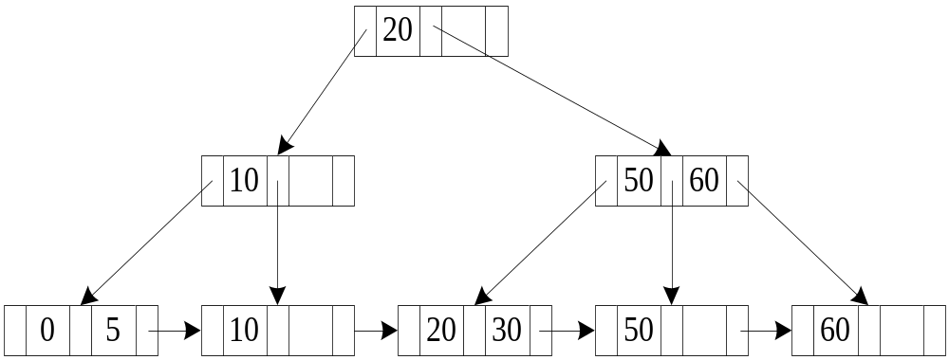
Example: Index Locking on a B+ -Tree
11<= search key <=51
0------
5------
10------
20------
30------
S
S
S
S
S
50------
S
60------

Slide 34
Next-Key Locking To Prevent Phantoms
Index-locking protocol to prevent phantoms required locking entire leaf
  Can result in poor concurrency if there are many inserts
Next-key locking protocol: provides higher concurrency
  Lock all values that satisfy index lookup (match lookup value, or fall in lookup range)
  Also lock next key value in index
    even for inserts/deletes
  Lock mode: S for lookups, X for insert/delete/update
Ensures that range queries will conflict with inserts/deletes/updates
  Regardless of which happens first, as long as both are concurrent

Slide 35
Multiversion Concurrency Control Schemes
Multiversion schemes keep old versions of data item to increase concurrency.
Each successful write results in the creation of a new version of the data item written.
Use timestamps to label versions.
When a read(Q) operation is issued, select an appropriate version of Q based on the timestamp of the transaction, and return the value of the selected version.
Read only transactions never have to wait as an appropriate version is returned immediately for every read operation..
Q: <Q1, 1> , <Q2, 2> , <Q3, 3>

Slide 36
Multiversion Two-Phase Locking
Differentiates between read-only transactions and update transactions
  SET TRANSACTIOIN READ ONLY;
  SET TRANSACTION READ WRITE;
Update transactions
  Acquire read and write locks
  Hold all locks up to the end of the transaction. That is , follow rigorous two-phase locking.
  Each successful write results in the creation of a new version of the data item written.
  Each version of a data item has a single timestamp whose value is obtained from a counter ts-counter that is incremented during commit processing.
Read-only transactions
  Assigned a timestamp by reading the current value of ts-counter before they start execution.
  When a read-only transaction T_{i} issues a read(Q), the value returned is the contents of the version whose timestamp is the largest timestamp less than or equal to TS(T_{i})

Slide 37
Multiversion Two-Phase Locking (Cont.)
When an update transaction wants to read a data item:
  it obtains a S lock on it, and reads the latest version.
When an update transaction wants to write an item
  it obtains X lock on; it then creates a new version of the item and sets this version's timestamp to ∞.
When update transaction T_{i} completes, commit processing occurs:
  T_{i} sets timestamp on the versions it has created to ts-counter + 1
  T_{i} increments ts-counter by 1
  Unlock all locks it holds
(1) S lock
Q: <Q1, 1> , <Q2, 2> , <Q3, 3>
(2) Read the latest version
(1) X lock
Q: <Q1, 1> , <Q2, 2> , <Q3, 3>, <Q4 , ∞>
(2) Create a new version (ts←∞)
Q: <Q1, 1> , <Q2, 2> , <Q3, 3>, <Q4 , 4>
(1) Sets timestamp of created versions
(2) Increments ts-counter +1
3
4

Slide 38
Multiversion Two-Phase Locking (Cont.)
When a read-only transaction T_{i} issues a read(Q), the value returned is the contents of the version whose timestamp is the largest timestamp less than or equal to TS(T_{i})
Only serializable schedules are produced.
Q: <Q1, 1> , <Q2, 2> , <Q3, 3> , <Q4, 4>
T3
T4
D: <D1, 1> , <D3, 3>

Slide 39
MVCC: Implementation Issues
Creation of multiple versions increases storage overhead
  Extra tuples
  Extra space in each tuple for storing version information
Obsolete versions should be garbage collected
  Keep the youngest version Q_{k} among all versions whose timestamp is less than or equal to the timestamp of the oldest read-only transaction in the system, all other versions older than the Q_{k} can be deleted.
Q: <Q1, 1> , <Q2, 2> , <Q3, 3> , <Q4, 4>
garbage
T4
T5
D: <D1, 1> , <D3, 3>

